Slide 1



Post-Sixth Form Information Evening

Slide 2
Post-Sixth Form Information Evening
  Why go on to higher education?
  What subject to study?
  Selecting a university?
  What is UCAS?
  How much will it cost?
  Why choose an apprenticeship
  Types of apprenticeship
  Finding and applying to apprenticeships
  Work experience

Slide 3

Why go on to Higher Education?
Increase your knowledge
Get your first true taste of independence and freedom
Gain a qualification that’s internationally recognised
Develop the essential skills you’ll need in your career and working life
Increase your earning potential
Experience student life

Slide 4

Which Subject?
It’s important you choose a subject you
enjoy and will help you reach your
goals.
Think about what you enjoy day-to-day – maybe this could be part of a future job role?
Explore different job sites and graduate career options to look for ideas on what you’d like to do once you've finished your studies.
Speak to others who have studied courses you may be interested in or know you well.

Slide 5

Selecting a University
‘Russell Group’ Universities
  24 leading research intensive universities
  Not always the most selective
  Graduates from the top UK universities were earning more than graduates from other UK universities (ONS)
TEF - The TEF is an measure introduced by the government in England, to assess higher education providers’ levels of excellence in terms of teaching and ensuring students get good outcomes
Use comparison sites such as:
www.unistats.com
Notes:
One of The most frequent question I am asked is ‘Whats the best university?’ – There is no correct answer
Local/ Distance
Campus/City
Accommodation
Subject
Part time
Is it a Russell Group university? Top 24 Leading Research Universities
Includes Oxford, Cambridge, Manchester, Durham, LSE, Imperial, Liverpool, Birmingham and many others
It is important to look at the TEF rating for universities you are considering:
They measure:
Teaching quality: the extent to which teaching stimulates and challenges students, and maximises their engagement with their studies.
Learning environment: the effectiveness of resources and activities (such as libraries, laboratories and work experience) which support learning and improve retention, progression and attainment.
Student outcomes and learning gain: the extent to which all students achieve their educational and professional goals, in particular students from disadvantaged backgrounds.

Slide 6

What is UCAS?
Universities and Colleges Admissions Service
Time scale for applications:
APPLY EARLY!!
Mid October 2020 | Cambridge, Oxford, Medicine, Dentistry, Veterinary
January 2021 | All others
Mid-March 2021 | Route B: Art and Design
Notes:
Universities and Colleges Admissions Service is a central application service. We will be launching this with students after their end of year exams in June
There are no paper forms – its all done online.
There are three important deadlines:
Mid Oct for those applying to Cambridge, Oxford or courses in medicine, dentistry or veterinary science/medicine.
Mid-Jan – for everything else except route B art and design courses – although worth noting that as we have to process all applications, check, add references etc the internal deadline is the beginning of November
Between Jan 1 and mid march for route B art and design courses
An early application is always worth achieving / Offers can begin as early as October

Slide 7
Choices of university and subject
Maximum of 5 choices
Consider entrance requirements carefully:
  1 or 2 choices higher than realistic predicted grades
  2-3 choices around predicted grades
  1-2 safeguards of lower grade offers
Entrance tests / Interviews
Grade | Tariff
A* | 56
A | 48
B | 40
C | 32
D | 24
E | 16
Notes:
Each student has a maximum of 5 choices with some restrictions:
Max is 4 with medicine, vet medicine (1 additional allowed)
Can only pick 3 if applying for art and design through route B
Students can only choose either Oxford or Cambridge
There is no obligation to use all 5 choices but students are advised to do so. Students should pay careful attention to the entry requirements and make appropriate choices. Applying for 5 courses all requiring the same entry requirements of AAB when predicted grades are BCC will result in disappointment. Aim for 1-2 choices higher than the realistic predictions, two or three around the predicted grade levels and include one or two safeguards of likely lower grade offers.
Some universities will ask for points some will ask for grades
Universities are finding it increasingly difficult to distinguish between applicants and testing is used in some cases:
LNAT – Law
BMAT and UKCAT for Medicine and Dentistry
Important to research what requirements each University has.
Many very competitive universities will want to interview students as part of the selection process – we will provide Mock interviews and interview workshops for students who need to prepare for one in the autumn term

Slide 8


Year 12 Haydon Challenge a platform for success
  All students
  Reading Marathon
  MOOCs
  Community Leadership
  Work Experience 13th – 17th July

Slide 9
Student Top Tips for
Success
Head Boy Head Girl
Prajesh Chauhan Lauren Smith-Warwick
Why have you chosen to apply for University?
What did you find most challenging about the application process?
What piece of advice would you give for students to help with their applications?
What offers have you received?

Slide 10

Unifrog Sophie Oulton Regional Advisor
Unifrog is the online destinations platform that all Haydon Students should use to:
Research careers/subjects and find links to wider academic engagement (such as Moocs)
Search for and compare University courses and create shortlists
Record activities that can be used later in a personal statement
Draft a personal statement
Parent login - www
parenthaydon

Slide 11
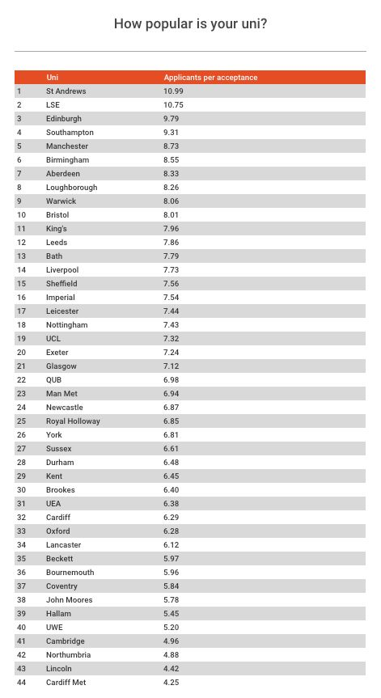
What are Admissions
Tutors looking for?
Academic grades to meet the entrance criteria (some will look at GCSEs as well as A Levels and BTECs)
Intellectual ability, but importantly they are looking for academic potential
Your Personal Statement is your chance to prove your commitment to a subject and to furthering your education. It is much more than “just good grades”
What can you do to develop and build experience and evidence to use on your Personal Statement?....

Slide 12
What about the cost?
Choosing University will be the most expensive option and courses
often charge up to £9,250 per year of study, but it is important to understand what support you will receive to cover this.
Tuition fee loans - cover the full cost of your course, are paid directly to the course provider, and you won’t have to pay it back until after your course, when you’re earning above a certain level.
Maintenance loans - can be applied for at the same time, lending you money at the start of each term to help with living expenses. How much you get depends on your household income, where you study, where you live and how long for. As with Tuition fee loans you won’t have to pay it back until after your course, when you’re earning above a certain level.

Slide 13


Other Sources
University Bursaries
Scholarships
Disability or learning support allowances
University hardship funds
Corporate sponsorship

Slide 14

It is important to remember….
UNIVERSITY IS NOT FOR EVERYONE
Notes:
Unifrog is a platform to help you find apprenticeships as well as university

Slide 15







Higher and Degree apprenticeships
They offer many of the benefits of higher education without the cost as your tuition fees are paid for by your employer and the Government. You will not only be learning, but earning a salary, from day one.
Universities offer their degree apprentices exactly the same student experience as other students, so you will still have access to the student union, sports facilities, student discounts etc.
With an apprenticeship, you gain the competitive advantage of gaining at least 3 years’ work experience whilst completing your degree.
But remember – it’s hard work as a degree apprentice.
You’ll be working full time and fitting in the equivalent of a
full time degree alongside it. It might take a bit longer, 4 years
instead of 3, but you’ll achieve exactly the same degree.

Slide 16
Levels of apprenticeship
Apprenticeship Type | Value of qualification | Equivalent to academic study | Typical entry Requirements
Degree Apprenticeship | Level 6 & 7 | Bachelors degree or Masters degree | A Levels (UCAS points score)
Higher Apprenticeship | Level 4 & 5 | Certificate of Higher education or Diploma of Higher Education | A Levels (UCAS points score)
Advanced Apprenticeship | Level 3 | 2 A Levels or IB | GCSE A - C
Intermediate Apprenticeship | Level 2 | 5 GCSEs A*-C | GCSE pass at D - G
Notes:
There are now 4 distinct levels of apprenticeships, these are intermediate, advanced, higher and degree.

Slide 17









Companies offering competitive Degree Apprenticeships include…
National Apprenticeships Week 4^{h} – 9th March
Notes:
Here are some of the companies offering degree apprenticeships. Information is usually found on their websites.

Slide 18
Work experience
All students are expected to complete 5 days of work experience at the end of the academic year – 13th-17th July
This will give students an insight into a future career path, help them develop skills needed in the workplace, and strength personal statements and CV’s
Work experience – getting a reference demonstrates your competence in that line of work (or transferable skills)
All students should have received a pack in PSHE this week
Please read this carefully – it should explain everything clearly
Students will need to have secured a placement by the time they return after the Easter Holidays
Please pay close attention to the two forms that need to be returned –
Parental consent form – Monday 24th Feb
Work experience placement form – Monday 27th April

Slide 19
Key Dates
Summer Term
27th April – Work experience placement secured
8th- 18th June – UCAS exams
3rd July – Higher Education Day – registering for UCAS and starting application / or CV writing + interview workshops
10th July – Deadline for draft of personal statement
13th-17th July – Work experience week
Autumn Term
15th October – Oxbridge + Medicine application Deadline
2nd November – Internal Deadline for all other University Applications

